Slide 1

Multi-Hop Retrieval for Question Answering: Improving Evidence Selection for RAG
University of Hertfordshire
Saif Ali Jan
24065142

Slide 2
introduction
Multi-hop question answering requires combining evidence from multiple documents, and this project explores how better evidence selection in RAG can improve answer quality on HotpotQA.
Motivation
Standard RAG pipelines often miss key linking facts or retrieve distracting passages, so improving evidence selection is important for more accurate, explainable, and reliable answers.
Research Question
Can a QA model accurately answer multi-hop questions by reasoning across multiple Wikipedia documents while also identifying the correct supporting facts?

Slide 3
Overview if previous work related to the project
Paper 1: Aksoy et al. (2025) showed that RAG performance in multi-hop QA depends heavily on dataset characteristics, and that better semantic matching such as BERTScore can improve evidence retrieval.
Paper 2: Zhu et al. (2025) found that multi-hop RAG with iterative query refinement and fine-tuning outperformed single-hop RAG, especially by reducing hallucinations in complex medical QA tasks.
Paper 3: Shi et al. (2024) proposed retrieval-augmented knowledge editing, showing that relevance-based retrieval and pruning of uncertain facts can improve multi-hop reasoning quality.
Paper 4: Zhuang et al. (2024) introduced EfficientRAG, which improves multi-hop retrieval by filtering irrelevant evidence and refining queries more efficiently, reducing both noise and computation cost.

Slide 4
What will you do and how does it compare to the previous work?
Multi-hop question answering requires combining evidence from multiple documents, and this project explores how better evidence selection in RAG can improve answer quality on HotpotQA.
Motivation
Standard RAG pipelines often miss key linking facts or retrieve distracting passages, so improving evidence selection is important for more accurate, explainable, and reliable answers.
Research Question
Can a QA model accurately answer multi-hop questions by reasoning across multiple Wikipedia documents while also identifying the correct supporting facts?

Slide 5
What will you do and how does it compare to the previous work?
I will build and test a multi-hop RAG pipeline on HotpotQA that predicts both the final answer and the supporting facts, whereas some earlier studies mainly compared datasets or focused on other domains like biomedicine.
I will focus specifically on improving evidence selection by ranking and filtering passages across hops to reduce distractors and missing links, building on earlier ideas such as iterative retrieval, query refinement, and relevance pruning.
I will compare the method using both answer accuracy and supporting-fact overlap and analyse retrieval failure modes, which gives a more direct evaluation of evidence quality than prior work that focused more on model editing, fine-tuning, or retrieval efficiency alone.

Slide 6
DATASET
What it is: HotpotQA is a text-based, multi-hop question answering dataset where each example includes a question, answer, supporting facts, and context passages from Wikipedia, making it suitable for testing evidence selection in RAG.
Type of data: The dataset is text data and is hosted on Hugging Face in Parquet format, with examples organised into subsets such as distractor and fullwiki.
Size and link: The full dataset repository is about 747 MB in total; the distractor subset is about 359 MB and the fullwiki subset is about 387 MB. Dataset link: HotpotQA on Hugging Face.

Slide 7
Ethical implications
No personal data: HotpotQA contains text-based question-answer pairs and supporting Wikipedia passages, so the released dataset does not include direct personal or sensitive user data for this project.
Permission and anonymity: The dataset is distributed under CC BY-SA 4.0, meaning it can be used for research with proper attribution; the released records are based on public Wikipedia content and do not expose participant identities.
Secure handling: Even though the dataset is public and low-risk, project files should still be stored in secure, access-controlled storage and used only for the approved research purpose.

Slide 8
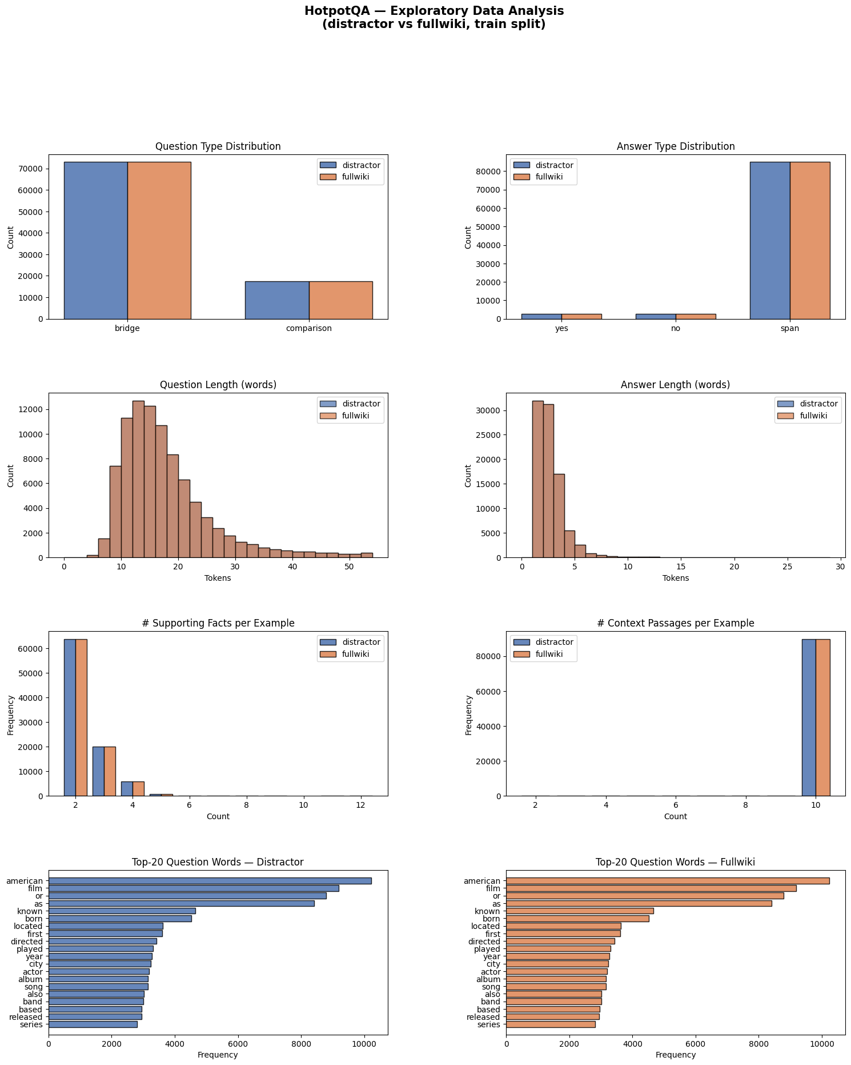
EDA
Balanced structure: The distractor and fullwiki train splits look almost identical, with far more bridge than comparison questions and most answers being short span-based responses rather than yes/no.
Length patterns: Question lengths are mostly around 10 to 20 words with a right-skewed tail, while answers are usually very short at around 1 to 3 words, which suggests concise target outputs but potentially complex retrieval.
Evidence profile: Most examples contain around 2 to 3 supporting facts and about 10 context passages, confirming that HotpotQA is a genuine multi-hop retrieval task where selecting the right evidence is crucial.

Slide 9
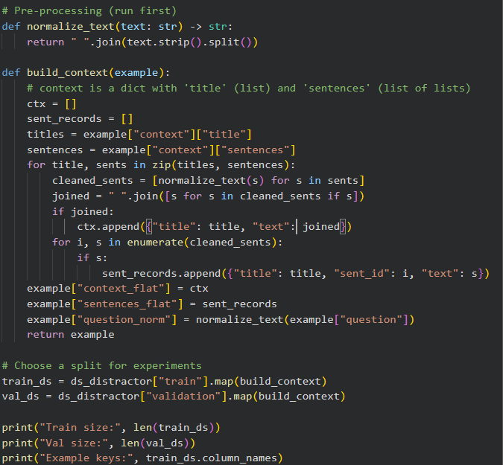
Pre-processing
Text cleaning: The preprocessing normalises whitespace in questions and context sentences so the input text is cleaner and more consistent for retrieval and modelling.
Context restructuring: It converts the original nested Wikipedia context into two flat views: one at the passage level for retrieval and one at the sentence level for supporting-fact analysis.
Experiment setup: The processed train and validation splits from the HotpotQA distractor set are prepared with added fields like question_norm, context_flat, and sentences_flat for downstream experiments.

Slide 10
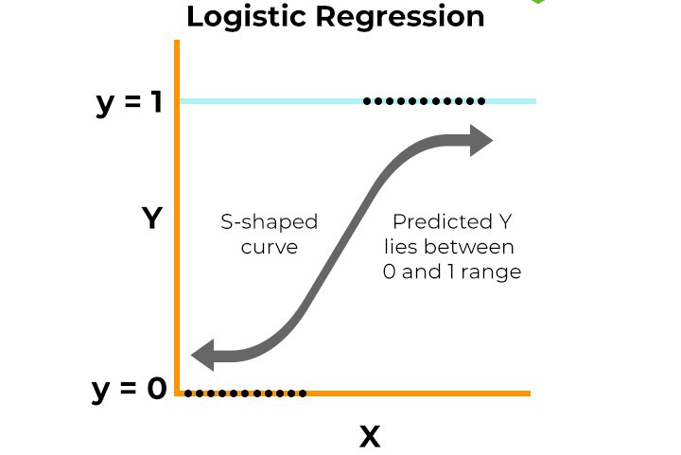
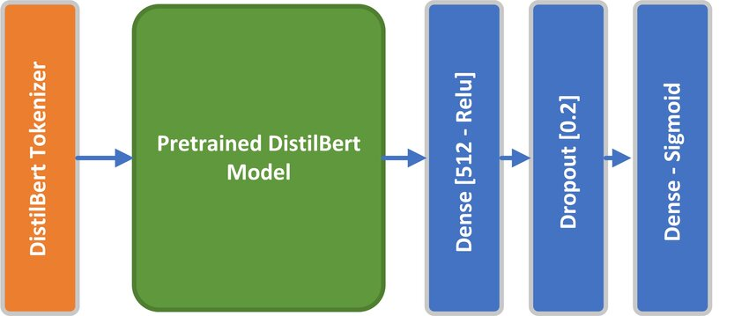
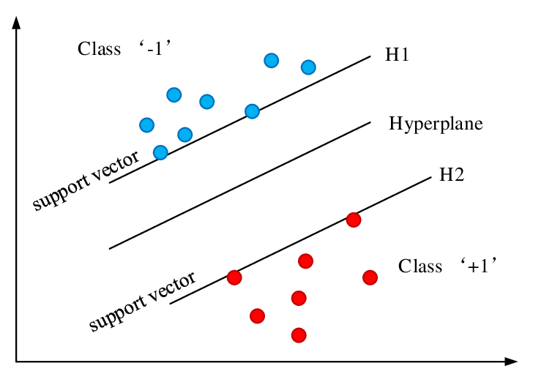
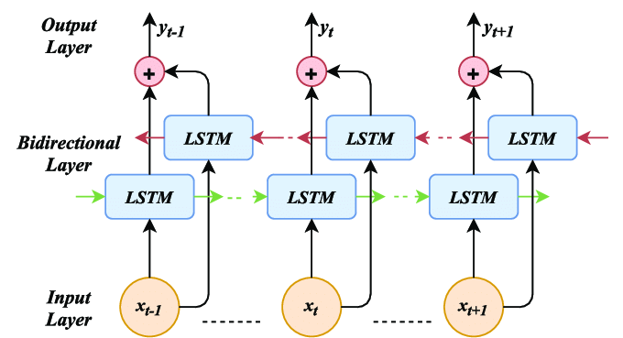
Model used
TF-IDF + Logistic Regression / Linear SVM: A strong baseline where each question-sentence pair is converted into TF-IDF n-gram features, then a classifier predicts whether the sentence is a supporting fact or a distractor.
Bi-LSTM Evidence Scorer: A sequential deep learning model that turns tokens into embeddings, reads them with a bidirectional LSTM, pools the hidden states, and outputs a binary relevance score for evidence selection.
DistilBERT + LoRA (main model): The final model uses DistilBERT with LoRA fine-tuning, so only small adapter weights are trained, giving a more efficient way to capture contextual meaning and improve supporting-fact prediction.

Slide 11
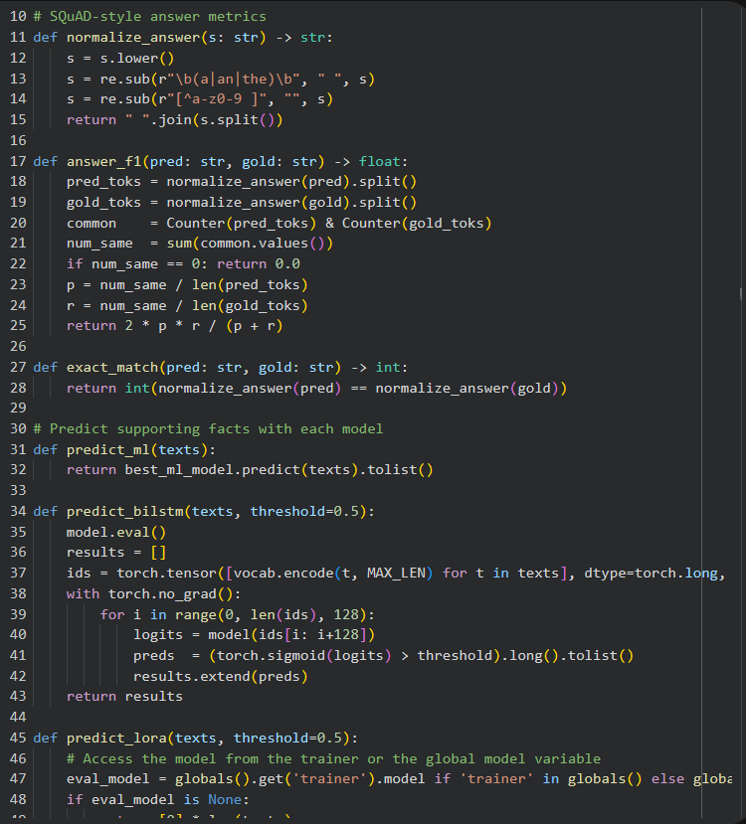
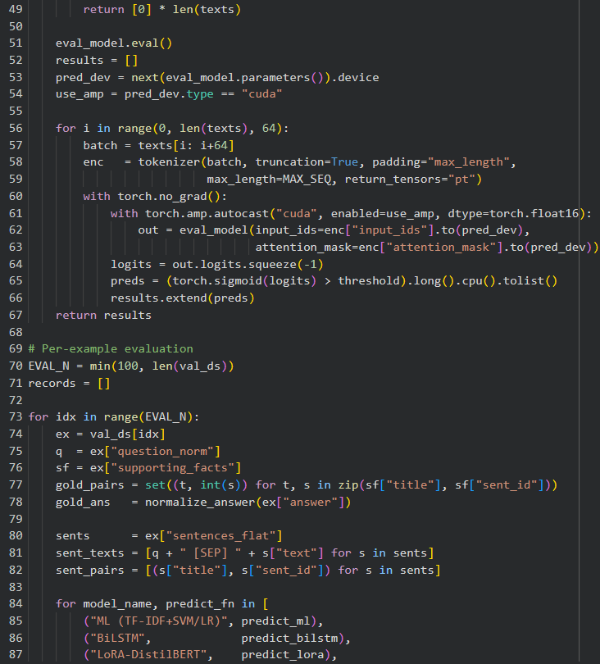
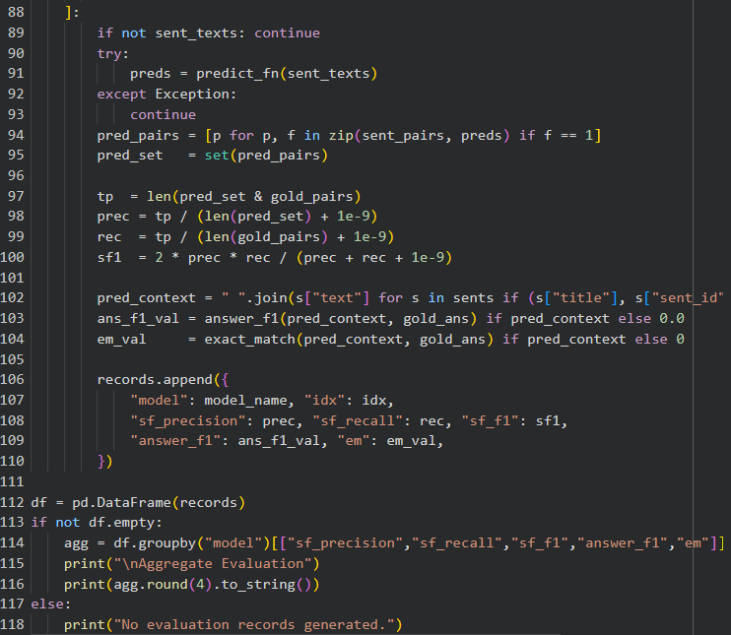

Model results
Baseline performance: Logistic Regression reached 84% accuracy and Linear SVM 88% accuracy, but supporting-fact detection stayed weak with only 0.23 and 0.22 F1, showing that overall accuracy is inflated by the large number of distractor sentences.
Confusion matrix insight: Both ML models classify distractors well but struggle on the supporting class, with very low precision (0.16 to 0.17) and modest recall (0.29 to 0.41), meaning many true evidence sentences are still missed or confused with non-evidence.
Best model and epochs: After 3 training epochs, LoRA-DistilBERT gave the strongest retrieval performance with sf_precision 0.545, sf_recall 0.523, and sf_f1 0.485, clearly outperforming the ML baseline, although answer F1 remained low, so evidence selection improved more than final answer generation.

Slide 12
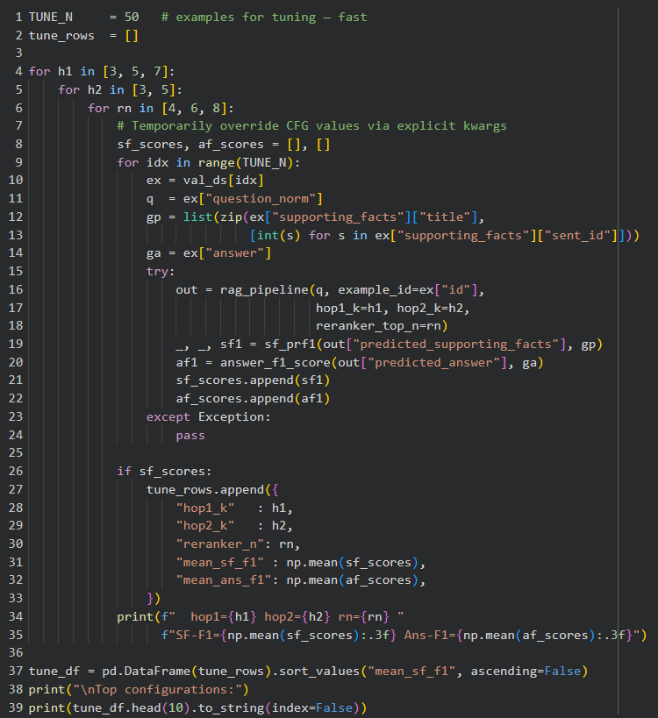
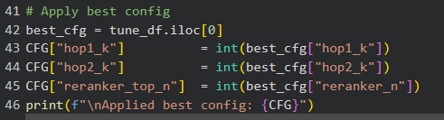
Hyperparameter tuning
LoRA setup: Hyperparameter tuning focused on LoRA adapters with r = 16, alpha = 32, and dropout = 0.1, applied to the transformer attention layers (q, k, v) so the model could adapt efficiently without full fine-tuning.
Training settings: The model was trained for 3 epochs with learning rate = 1e-4, max sequence length = 256, batch sizes = 32/64, and warmup ratio = 0.1 to balance stability, speed, and memory use.
Model selection: The best checkpoint was chosen using supporting-fact F1 on the validation set, and class-weighted loss was used during tuning to handle the strong imbalance between supporting facts and distractor sentences.

Slide 13
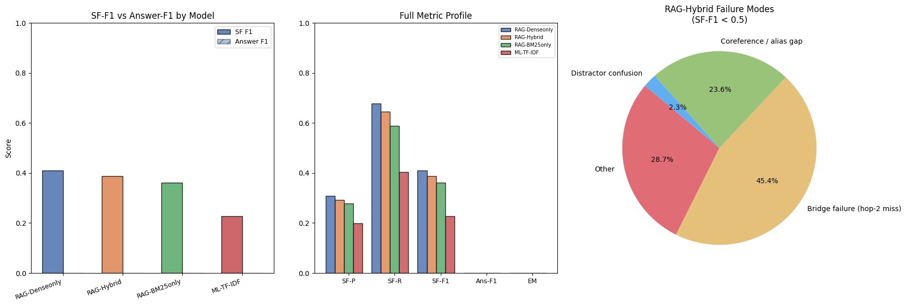
analysis
The results are promising but not fully satisfactory because evidence selection improved to around 0.48 SF-F1, but final answer performance is still very low, so the system retrieves better than it answers.
For this project, 50% is acceptable as an early baseline for multi-hop retrieval, but it is not strong enough for a reliable QA system; a more useful target would be closer to 80% for evidence quality, especially if the goal is robust end-to-end RAG.
The main next steps are to fix hop-2 bridge failures, improve sentence-level reranking, and strengthen the answer generation stage, since the analysis shows many errors come from selecting the wrong sentence or failing after retrieving the right evidence.

Slide 14
Summary and conclusions
Applied a multi-hop RAG / LoRA-enhanced evidence selection model to HotpotQA to predict supporting facts from question-context pairs and improve downstream answer generation.
The system achieved about 48% supporting-fact F1 on the best setup, while the ML baseline reached 88% accuracy but much lower evidence quality, showing that F1 is the more meaningful metric for this task.
With hyperparameter tuning, the best result came from the tuned RAG-Hybrid / LoRA-based setup; next steps are to improve hop-2 retrieval, sentence reranking, and answer generation to raise end-to-end QA performance.

Slide 15
THANK YOU!

